Slide 1
Module 4
Fundamental Cloud Architectures

Slide 2
Contents
Workload distribution architecture
Resource pooling architecture
Dynamic scalability architecture
Elastic resource capacity architecture
Service load balancing architecture
Cloud bursting architecture
Elastic disk provisioning architecture
Redundant storage architecture
Cloud operations: Migration, static and dynamic Scheduling

Slide 3
4.1 Workload Distribution Architecture
IT resources can be horizontally scaled by adding one or more identical IT resources and a load balancer that can evenly distribute the workload among the available IT resources.
Which reduces both IT resources over utilization and under utilization to their extend depending on the load balancing algorithms and runtime logic.

Slide 4
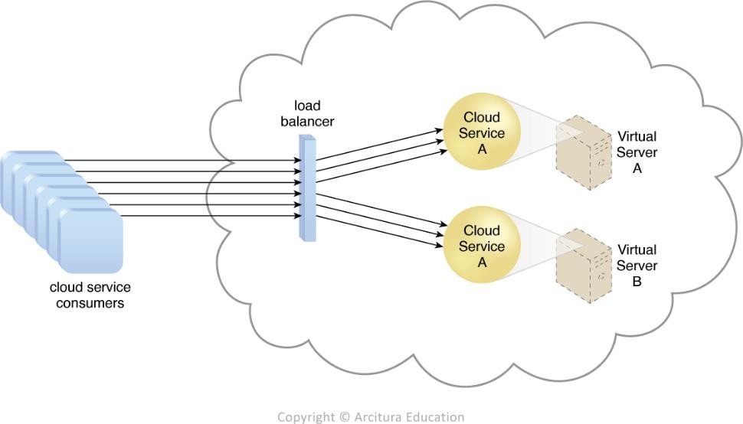
A redundant copy of Cloud Service A is implemented on virtual Server B. The load balancer intercepts cloud service consumer requests and directs them to both virtual Servers A and B to ensure even workload distribution.

Slide 5
Workload distribution systems
This type of architecture can be applied to any IT resource with workload distribution to
virtual servers
cloud storage devices
cloud services.

Slide 6
Load balancing systems
Load balancing systems applied to specific IT resources usually produce specialized variations of this architecture that incorporate aspects of load balancing, such as:
The service load balancing architecture
The load balanced virtual server
The load balanced virtual switches architecture

Slide 7
Load balancing can be applied to the following mechanisms in cloud architectures
Audit monitors
When distributing runtime workloads, the type and geographical location of the IT resources that process the data can determine whether monitoring is necessary to fulfill legal and regulatory requirements.
Cloud usage monitor
Various monitors can be involved to carry out the runtime workload tracking and data processing.
Hypervisor
Workloads between hypervisors and the virtual servers that they may require distribution.
Logical Network Perimeter
The logical network perimeter isolates cloud consumer network boundaries in relation to how and where workloads are distributed.
Resource Cluster
Clustered IT resources in active/passive mode are commonly used to support workload balancing between different cluster nodes.
Resource Replication
This mechanism can generate new instances of virtualized IT resources in response to runtime workload distribution demands.

Slide 8
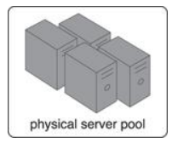
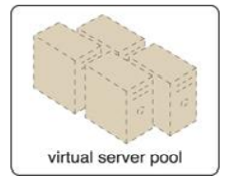
4.2 Resource Pooling Architectures
A resource pooling architecture is based on the use of one or more resource pools, in which identical IT resources are grouped and maintained by a system that automatically ensures that they remain synchronized.
Different resource pools are
Physical server pools: which are composed of networked servers that have been installed with operating systems and other necessary programs and/or applications and are ready for immediate use.
Virtual server pools: Virtual server pools are usually configured using one of several available templates chosen by the cloud consumer during provisioning. For example, a cloud consumer can set up a pool of mid-tier Windows servers with 4 GB of RAM or a pool of low-tier Ubuntu servers with 2 GB of RAM.

Slide 9
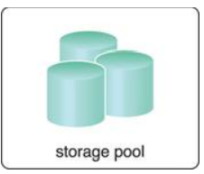
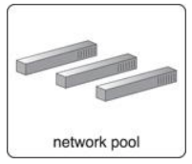
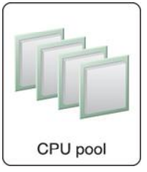
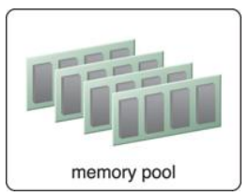
Storage pools: Storage pools, or cloud storage device pools, consist of file-based or block-based storage structures that contain empty and/or filled cloud storage devices.
Network pools: Network pools (or interconnect pools) are composed of different preconfigured network connectivity devices. For example, a pool of virtual firewall devices or physical network switches can be created for redundant connectivity, load balancing, or link aggregation.
CPU pools: CPU pools are ready to be allocated to virtual servers, and are typically broken down into individual processing cores.
RAM pools: Pools of physical RAM can be used in newly provisioned physical servers or to vertically scale physical servers.

Slide 10
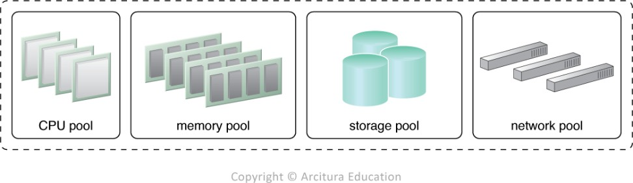
Figure - A sample resource pool that is comprised of four sub-pools of CPUs, memory, cloud storage devices, and virtual network devices.

Slide 11
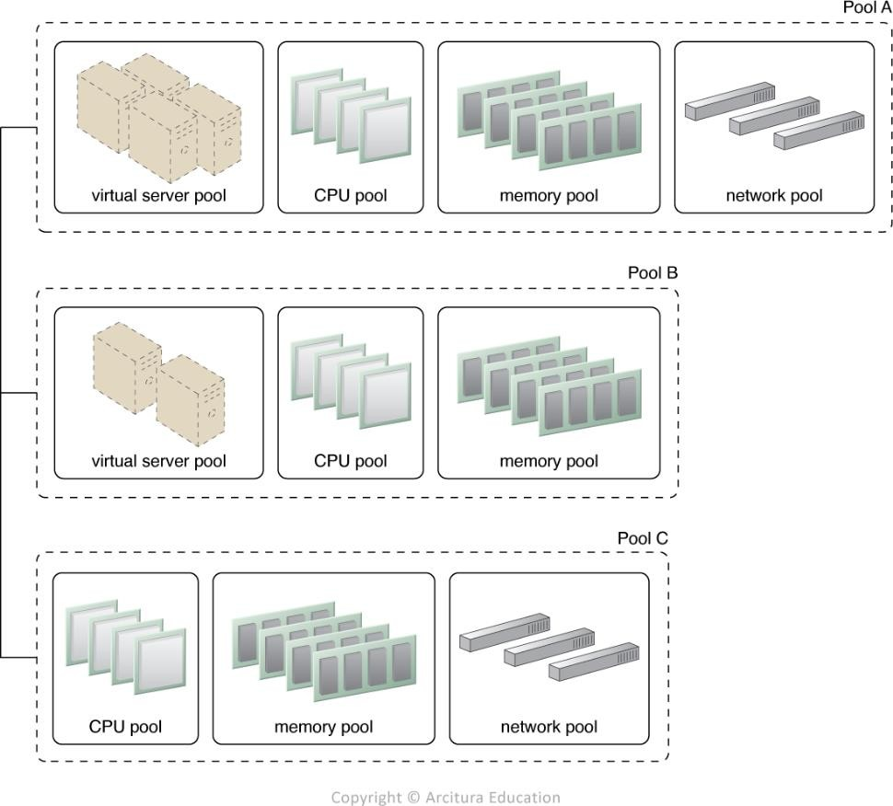
Resource pools can become highly complex, with multiple pools created for specific cloud consumers or applications. A hierarchical structure can be established to form parent, sibling, and nested pools in order to facilitate the organization of diverse resource pooling requirements.
Figure - Pools B and C are sibling pools that are taken from the larger Pool A, which has been allocated to a cloud consumer. This is an alternative to taking the IT resources for Pool B and Pool C from a general reserve of IT resources that is shared throughout the cloud.

Slide 12
Sibling resource pools are usually drawn from physically grouped IT resources.
Sibling pools are isolated from one another so that each cloud consumer is only provided access to its respective pool.
In the nested pool model, larger pools are divided into smaller pools that individually group the same type of IT resources together.
Nested pools can be used to assign resource pools to different departments or groups in the same cloud consumer organization.

Slide 13
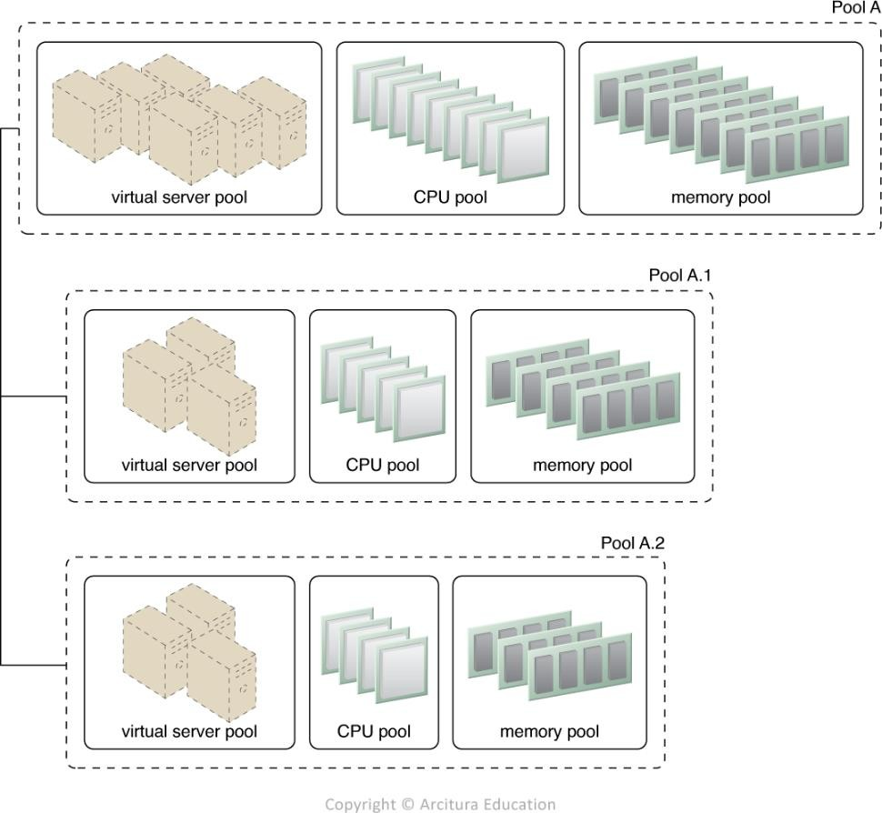
Figure - Nested Pools A.1 and Pool
A.2 are comprised of the same IT resources as Pool A, but in different quantities.

Slide 14
In addition to commonly pooled mechanisms of cloud storage devices and virtual servers, the following mechanisms can be part of this resource pooling architecture:
Audit monitor – monitors the usage of resource pool.
Cloud usage monitor – monitors the runtime tracking and synchronization required by Pooled IT resources.
Hypervisor -- responsible for providing virtual servers with access to resource pools.
Logical network perimeter--The logical network perimeter is used to logically organize and isolate resource pools.
Pay-per-use monitor-- collects usage and billing information on how individual cloud consumers are allocated and use IT resources from various pools.

Slide 15
Remote administration system -- This mechanism is commonly used to interface with backend systems and programs in order to provide resource pool administration features via a front-end portal.
Resource management system -- supplies cloud consumers with the tools and permission management options for administering resource pools.
Resource replication -- This mechanism is used to generate new instances of IT resources for resource pools

Slide 16
4.3 Dynamic Scalability Architecture
Which is based on a system of predefined scaling conditions that trigger the dynamic allocation of IT resources from resource pools.
Unnecessary IT resources are reclaimed without requiring any manual intervention.
The automatic scaling listener is configures with workload thresholds that dictates when new IT resource need to be added to the workload processing.
This mechanism provides a logic that automatically determines how many additional resources can be dynamically provided based on the consumers contract.

Slide 17
There are three types of dynamic scaling
Dynamic Horizontal Scaling- IT resources are scaled in and scaled out to handle workload fluctuations. The automatic scaling listener monitors request and signals resource replication to initiate resource duplication as per requirements and permissions.
Dynamic vertical Scaling
IT resources are scaled in and scaled out when there is a need to adjust the processing capacity of single IT resource .
Dynamic Relocation – The IT resource is relocated to a host with more capacity. For example, a database may need to be moved from a tape based SAN storage device with 4 GB per second I/O capacity to another disk-based SAN storage device with 8 GB per second I/O capacity.

Slide 18
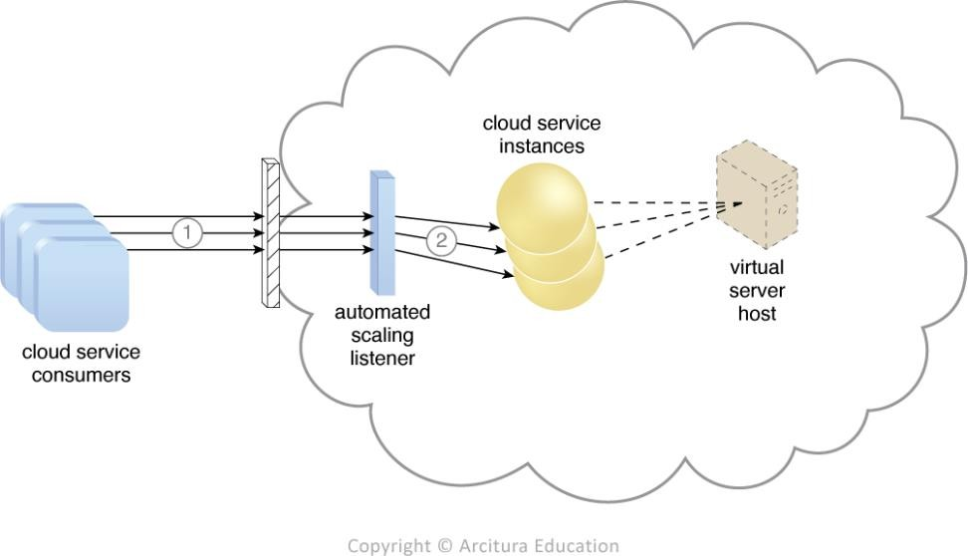
Processing of Dynamic Horizontal Scaling
Cloud service consumers are sending requests to a cloud service (1).
The automated scaling listener monitors the cloud service to determine if
predefined capacity thresholds are being exceeded (2).

Slide 19
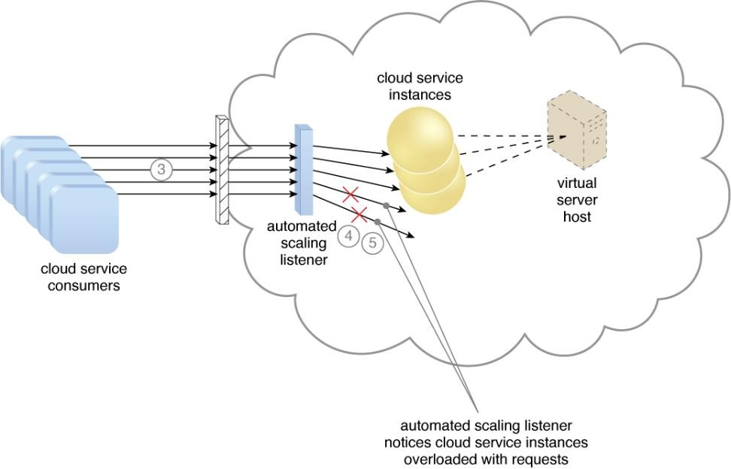
The number of service requests coming from cloud service consumers further increases (3). The workload exceeds the performance thresholds. The automated scaling listener determines the next course of action based on a predefined scaling policy (4).
If the cloud service implementation is deemed eligible for additional scaling, the automated scaling listener initiates the scaling process (5).

Slide 20
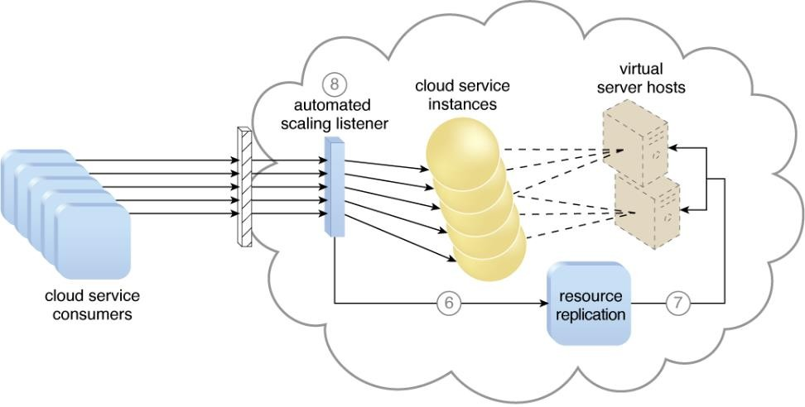
The automated scaling listener sends a signal to the resource replication mechanism (6), which creates more instances of the cloud service (7). Now that the increased workload has been accommodated, the automated scaling listener resumes monitoring and detracting and adding IT resources, as required (8).

Slide 21
The dynamic scalability architecture can be applied to a range of IT resources, including virtual servers and cloud storage devices.
Besides the core automated scaling listener and resource replication mechanisms, the following mechanisms can also be used in this form of cloud architecture:
Cloud Usage Monitor – Specialized cloud usage monitors can track runtime usage in response to dynamic fluctuations caused by this architecture.
Hypervisor – The hypervisor is invoked by a dynamic scalability system to create or remove virtual server instances, or to be scaled itself.
Pay-Per-Use Monitor – The pay-per-use monitor is engaged to collect usage cost information in response to the scaling of IT resources.

Slide 22
4.4 Elastic Resource Capacity Architecture
The elastic resource capacity architecture is primarily related to the dynamic provisioning of virtual servers, using a system that allocates and reclaims CPUs and RAM in immediate response to the fluctuating processing requirements of hosted IT resources.
The virtual server, its hosted applications, and IT resources are vertically scaled in response to dynamic processing power request.

Slide 23
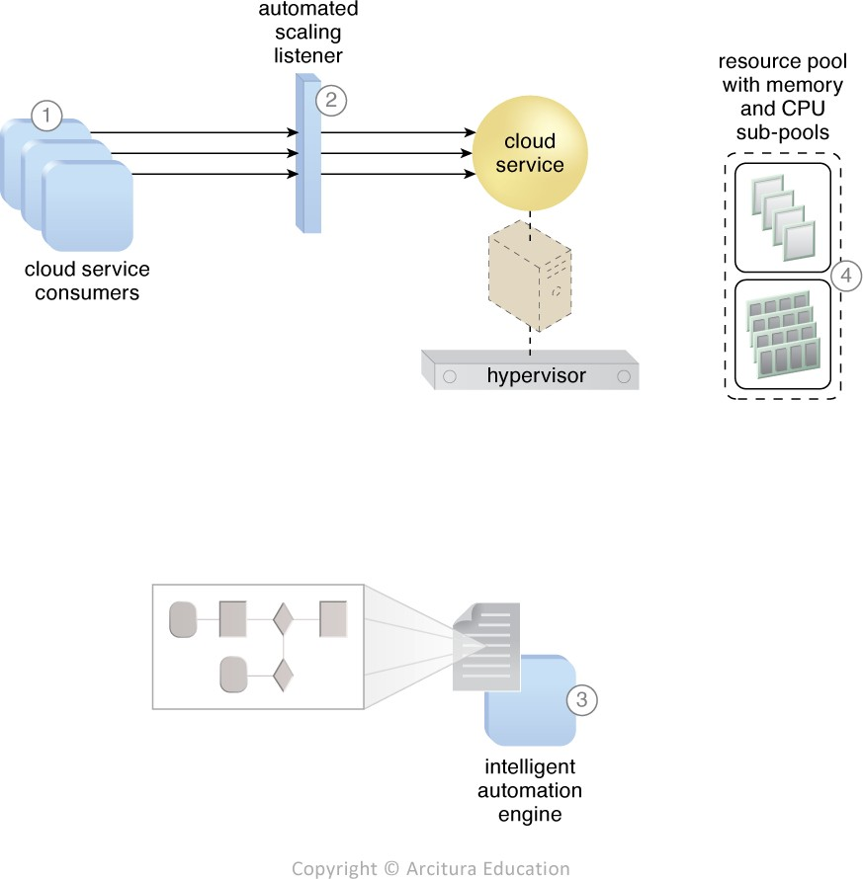
Cloud service consumers are actively sending requests to a cloud service (1), which are monitored by an automated scaling listener (2). An intelligent automation engine script is deployed with workflow logic (3) that is capable of notifying the resource pool using allocation requests (4).

Slide 24
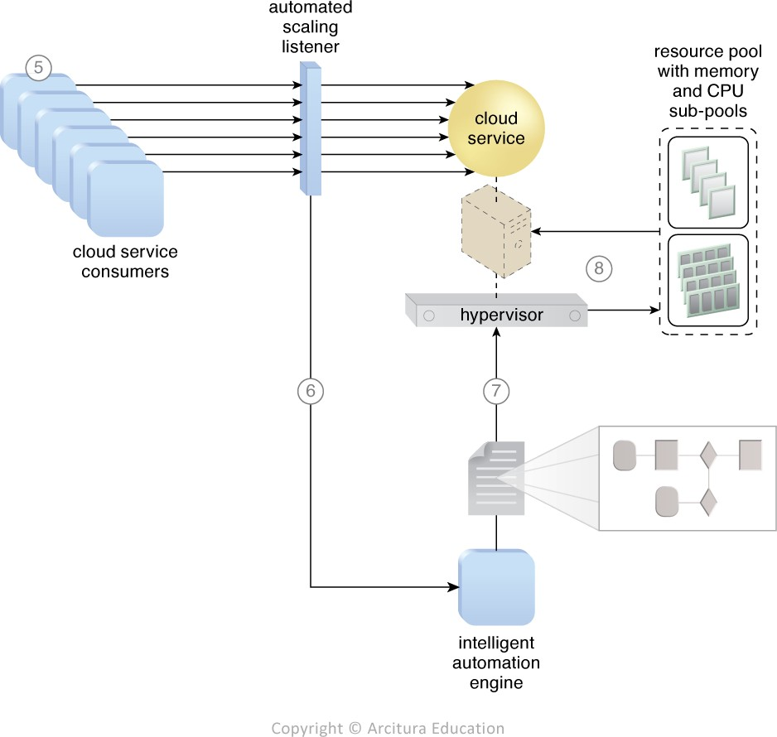
Cloud service consumer requests increase (5), causing the automated scaling listener to signal the intelligent automation engine to execute the script (6). The script runs the workflow logic that signals the hypervisor to allocate more IT resources from the resource pools (7). The hypervisor allocates additional CPU and RAM to the virtual server, enabling the increased workload to be handled (8).

Slide 25
Resource pools are used by scaling technology that interacts with the hypervisor and/or VIM to retrieve and return CPU and RAM resources at runtime.
It needs additional processing power to monitor the run time processing of virtual server via dynamic allocation of resources from resource pool.
The virtual server and its hosted applications and IT resources are vertically scaled in response.
This type of cloud architecture can be designed so that the intelligent automation engine script sends its scaling request via the VIM instead of to the hypervisor directly.
Virtual servers that participate in elastic resource allocation systems may require rebooting .

Slide 26
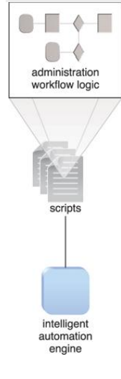
Intelligent Automation Engine
The intelligent automation engine automates administration tasks by executing scripts that contain workflow logic.

Slide 27
Some additional mechanisms that can be included in this cloud architecture are the following:
Cloud Usage Monitor – Specialized cloud usage monitors collect resource usage information on IT resources before, during, and after scaling, to help define the future processing capacity thresholds of the virtual servers.
Pay-Per-Use Monitor – The pay-per-use monitor is responsible for collecting resource usage cost information as it fluctuates with the elastic provisioning.
Resource Replication – Resource replication is used by this architectural model to generate new instances of the scaled IT resources.

Slide 28
4.5 Service Load Balancing Architecture
The service load balancing architecture can be considered a specialized variation of the workload distribution architecture that is geared specifically for scaling cloud service implementations.
Redundant deployments of cloud services are created, with a load balancing system added to dynamically distribute workloads.
The duplicate cloud service implementations are organized into a resource pool, while the load balancer is positioned as either an external or built-in component to allow the host servers to balance the workloads themselves.

Slide 29
Depending on the anticipated workload and processing capacity of host server environments, multiple instances of each cloud service implementation can be generated as part of a resource pool that responds to fluctuating request volumes more efficiently.
The load balancer can be positioned either independent of the cloud services and their host servers, or built-in as part of the application or server’s environment.

Slide 30
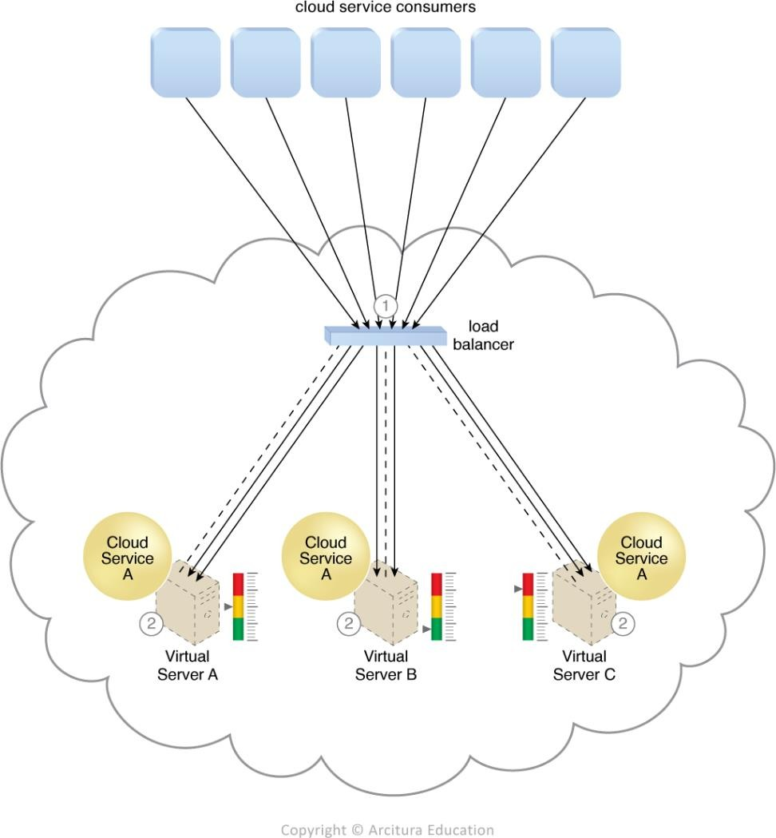
The load balancer intercepts messages sent by cloud service consumers (1) and forwards them to the virtual servers so that the workload processing is horizontally scaled (2)

Slide 31
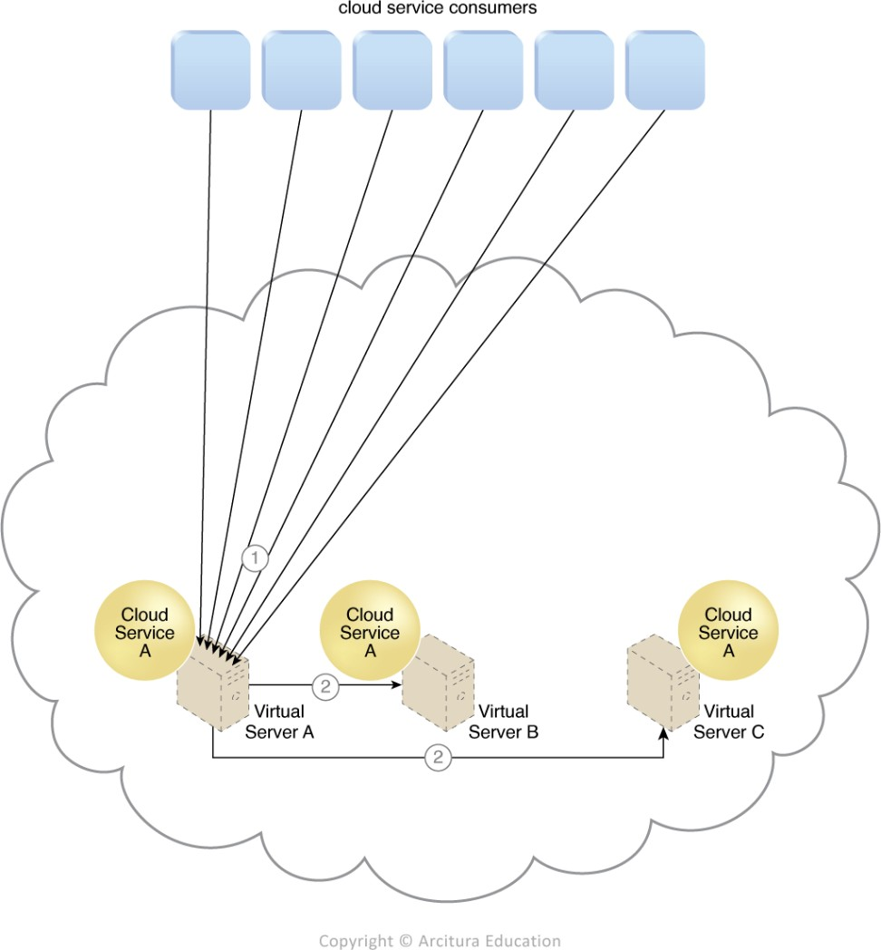
Cloud service consumer requests are sent to Cloud Service A on Virtual Server A (1). The cloud service implementation includes built-in load balancing logic that is capable of distributing requests to the neighboring Cloud Service A implementations on Virtual Servers B and C (2)

Slide 32
The service load balancing architecture can involve the following mechanisms in addition to the load balancer:
• Cloud Usage Monitor – Cloud usage monitors may be involved with monitoring cloud service instances and their respective IT resource consumption levels, as well as various runtime monitoring and usage data collection tasks.
• Resource Cluster – Active cluster groups are incorporated in this architecture to help balance workloads across different members of the cluster.
• Resource Replication – The resource replication mechanism is utilized to generate cloud service implementations in support of load balancing requirements.

Slide 33
4.6 Cloud Bursting Architecture
The cloud bursting architecture establishes a form of dynamic scaling that scales or “bursts out” on-premise IT resources into a cloud whenever predefined capacity thresholds have been reached.
The corresponding cloud-based IT resources are redundantly pre-deployed but remain inactive until cloud bursting occurs. After they are no longer required, the cloud-based IT resources are released and the architecture “bursts in” back to the on-premise environment.
Cloud bursting is a flexible scaling architecture that provides cloud consumers with the option of using cloud-based IT resources only to meet higher usage demands.

Slide 34
The foundation of this architectural model is based on the automated scaling listener and resource replication mechanisms.
The automated scaling listener determines when to redirect requests to cloud-based IT resources, and resource replication is used to maintain synchronicity between on-premise and cloud-based IT resources in relation to state information.
In addition to the automated scaling listener and resource replication, numerous other mechanisms can be used to automate the burst in and out dynamics for this architecture, depending primarily on the type of IT resource being scaled.

Slide 35
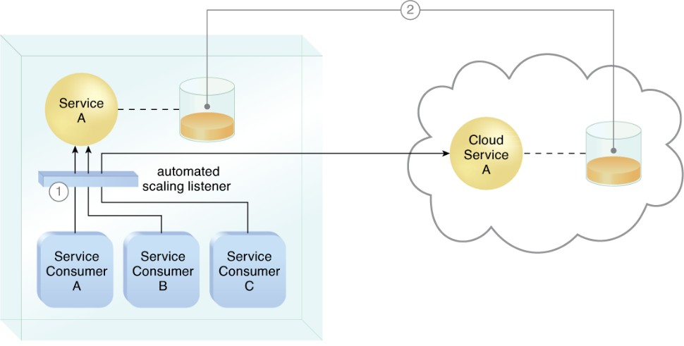
An automated scaling listener monitors the usage of on-premise Service A, and redirects Service Consumer C's request to Service A's redundant implementation in the cloud (Cloud Service A) once Service A's usage threshold has been exceeded (1). A resource replication system is used to keep state management databases synchronized (2).

Slide 36
4.7 Elastic Disk Provisioning Architecture
Cloud consumers are commonly charged for cloud-based storage space based on fixed-disk storage allocation, meaning the charges are predetermined by disk capacity and not aligned with actual data storage consumption.

Slide 37
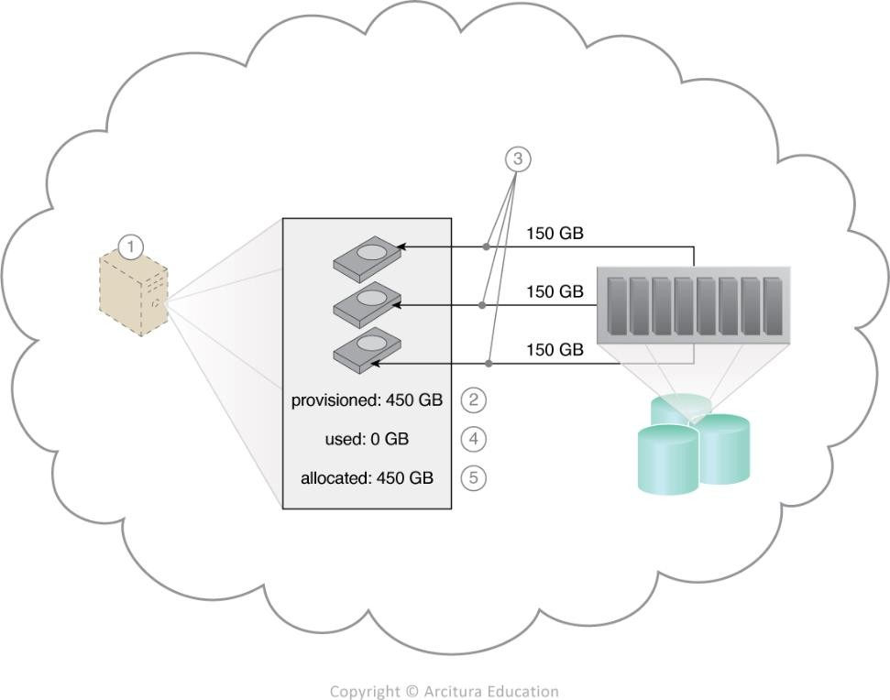
In which a cloud consumer provisions a virtual server with the Windows Server operating system and three 150 GB hard drives. The cloud consumer is billed for using 450 GB of storage space after installing the operating system, even though the operating system only requires 15 GB of storage space.
The cloud consumer requests a virtual server with three hard disks, each with a capacity of 150 GB (1). The virtual server is provisioned according to the elastic disk provisioning architecture, with a total of 450 GB of disk space (2). The 450 GB is allocated to the virtual server by the cloud provider (3). The cloud consumer has not installed any software yet, meaning the actual used space is currently 0 GB (4). Because the 450 GB are already allocated and reserved for the cloud consumer, it will be charged for 450 GB of disk usage as of the point of allocation (5).

Slide 38
The elastic disk provisioning architecture establishes a dynamic storage provisioning system that ensures that the cloud consumer is granularly billed for the exact amount of storage that it actually uses.
This system uses thin-provisioning technology for the dynamic allocation of storage space, and is further supported by runtime usage monitoring to collect accurate usage data for billing purposes.

Slide 39
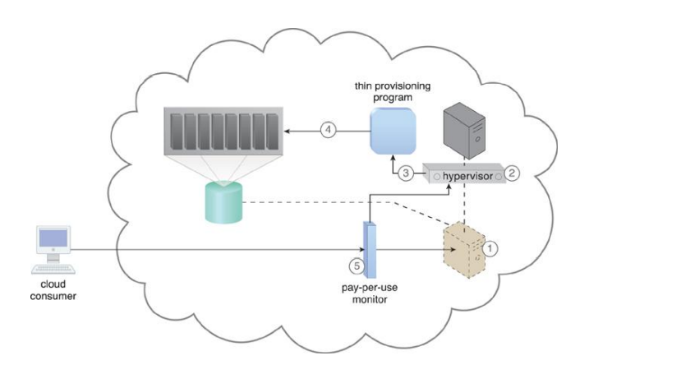
Thin-provisioning software is installed on virtual servers that process dynamic storage allocation via the hypervisor, while the pay-per-use monitor tracks and reports granular billing-related disk usage data .
A request is received from a cloud consumer, and the provisioning of a new virtual server instance begins (1). As part of the provisioning process, the hard disks are chosen as dynamic or thin-provisioned disks (2). The hypervisor calls a dynamic disk allocation component to create thin disks for the virtual server (3). Virtual server disks are created via the thin-provisioning program and saved in a folder of near-zero size. The size of this folder and its files grow as operating applications are installed and additional files are copied onto the virtual server (4). The pay-per-use monitor tracks the actual dynamically allocated storage for billing purposes (5)

Slide 40
The following mechanisms can be included in this architecture in addition to the cloud storage device, virtual server, hypervisor, and pay-per-use monitor:
• Cloud Usage Monitor – Specialized cloud usage monitors can be used to track and log storage usage fluctuations.
• Resource Replication – Resource replication is part of an elastic disk provisioning system when conversion of dynamic thin-disk storage into static thick-disk storage is required.

Slide 41
4.8 Redundant Storage Architecture
Cloud storage devices are occasionally subject to failure and disruptions that are caused by network connectivity issues, controller or general hardware failure, or security breaches.
The redundant storage architecture introduces a secondary duplicate cloud storage device as part of a failover system that synchronizes its data with the data in the primary cloud storage device.
Cloud providers may locate secondary cloud storage devices in a different geographical region than the primary cloud storage device, usually for economic reasons.
Some cloud providers use storage devices with dual array and storage devices in a different physical location for cloud balancing and disaster recovery purposes.

Slide 42
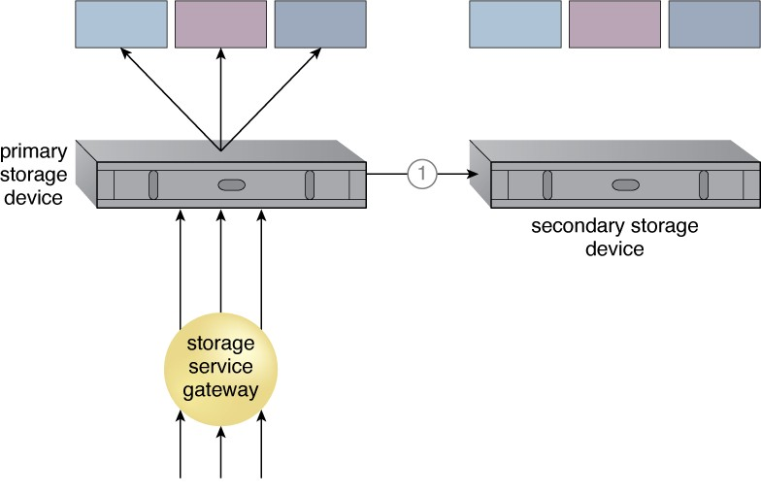
The primary cloud storage device is routinely replicated to the secondary cloud storage device .

Slide 43
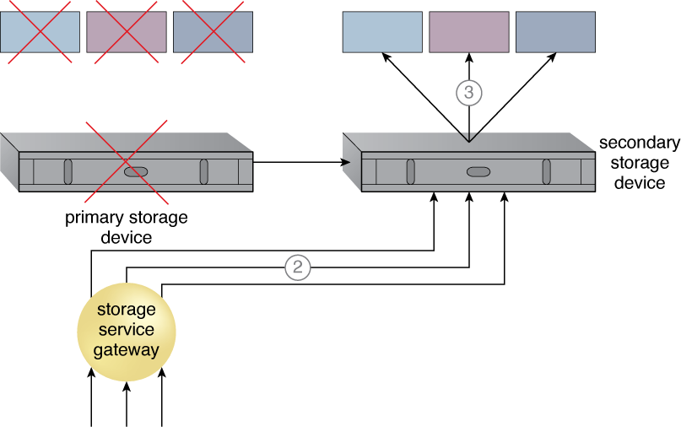
The primary storage becomes unavailable and the storage service gateway forwards the cloud consumer requests to the secondary storage device (2).
The secondary storage device forwards the requests to the LUN(Logic Unit Number)s, allowing cloud consumers to continue to access their data (3).

Slide 44
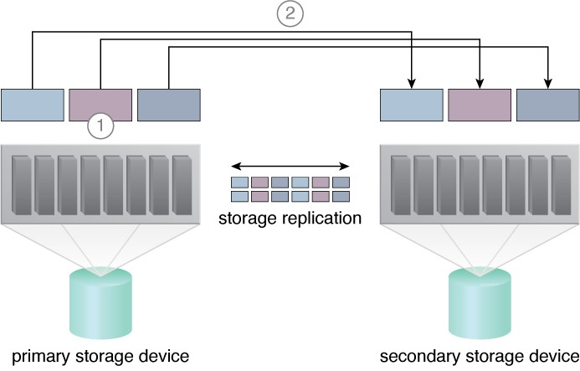
This cloud architecture primarily relies on a storage replication system that keeps the primary cloud storage device synchronized with its duplicate secondary cloud storage devices
Storage replication is used to keep the redundant storage device synchronized with the primary storage device.

Slide 45
Case study
As in-house solution that ATN did not migrate to cloud which uses remote upload module by clients to upload accounting and legal documents to central archive on daily basis. Usage peaks occur with out warning since the quantity of documents received on a day-by-day basis is unpredictable.
The remote upload module currently rejects upload attempts when it is operating at capacity, which is problematic for users need to archive documents before the end of business day.
Solution: ATN decides to take advantage of cloud environment by creating cloud bursting architecture. This enables it to burst into cloud whenever on-premise processing thresholds are exceeded.

Slide 46
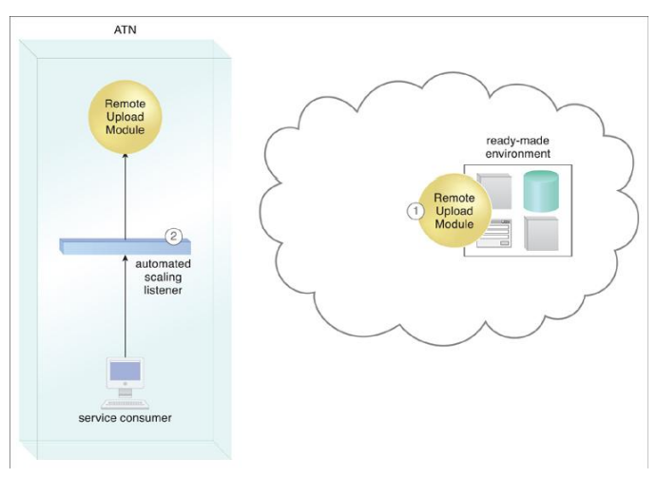
A cloud-based version of the on-premise Remote Upload Module service is deployed on ATN’s leased ready-made environment (1). The automated scaling listener monitors service consumer requests (2)

Slide 47
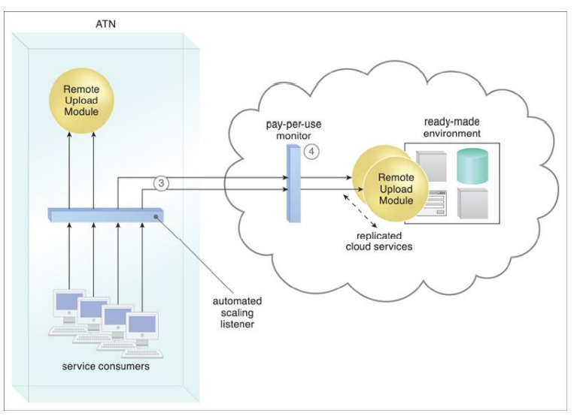
The automated scaling listener detects that service consumer usage has exceeded the local Remote Upload Module service’s usage threshold, and begins diverting excess requests to the cloud-based Remote Upload Module implementation (3). The cloud provider’s pay-per-use monitor tracks the requests received from the on-premise automated scaling listener to collect billing data, and Remote Upload Module cloud service instances are created on-demand via resource replication (4)

